Slide 1
Are you ready?

Slide 2



Software Tool Time

Slide 3


Slide 4
WebGL 1.0 Tutorial Lecture 11 – Texture
Tutor
Hwanyong “Grey Bear” LEE
Contents
Understanding texture mapping
How to use texture mapping in WebGL
Preparation
Previous lectures
Copy html and js file from
https://github.com/hwan-ajou/webgl-1.0
May 2021 / (CC-BY-NC) Hwanyong Lee and Ajou University

Slide 5
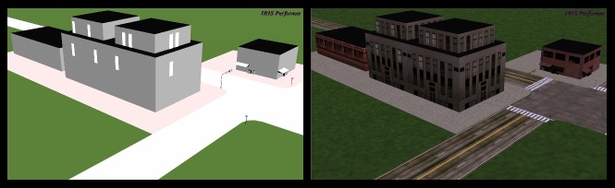
Why Texture Mapping ?
Geometric Modeling vs. Texture Mapping
geometric modeling : assign color value for each vertex
how many vertices we need to draw realistic?
texture mapping : wrap the real image on the surface
wallpaper
Make realistic rendering with low cost !

Slide 6
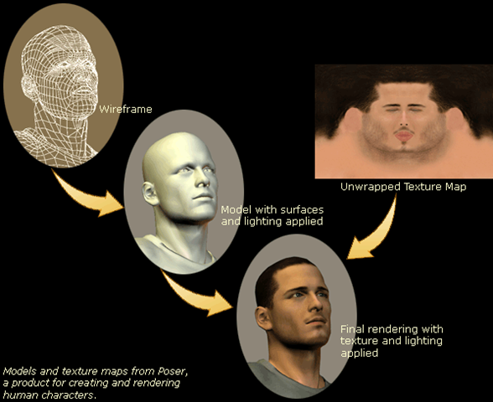
Texture Mapping Example

Slide 7
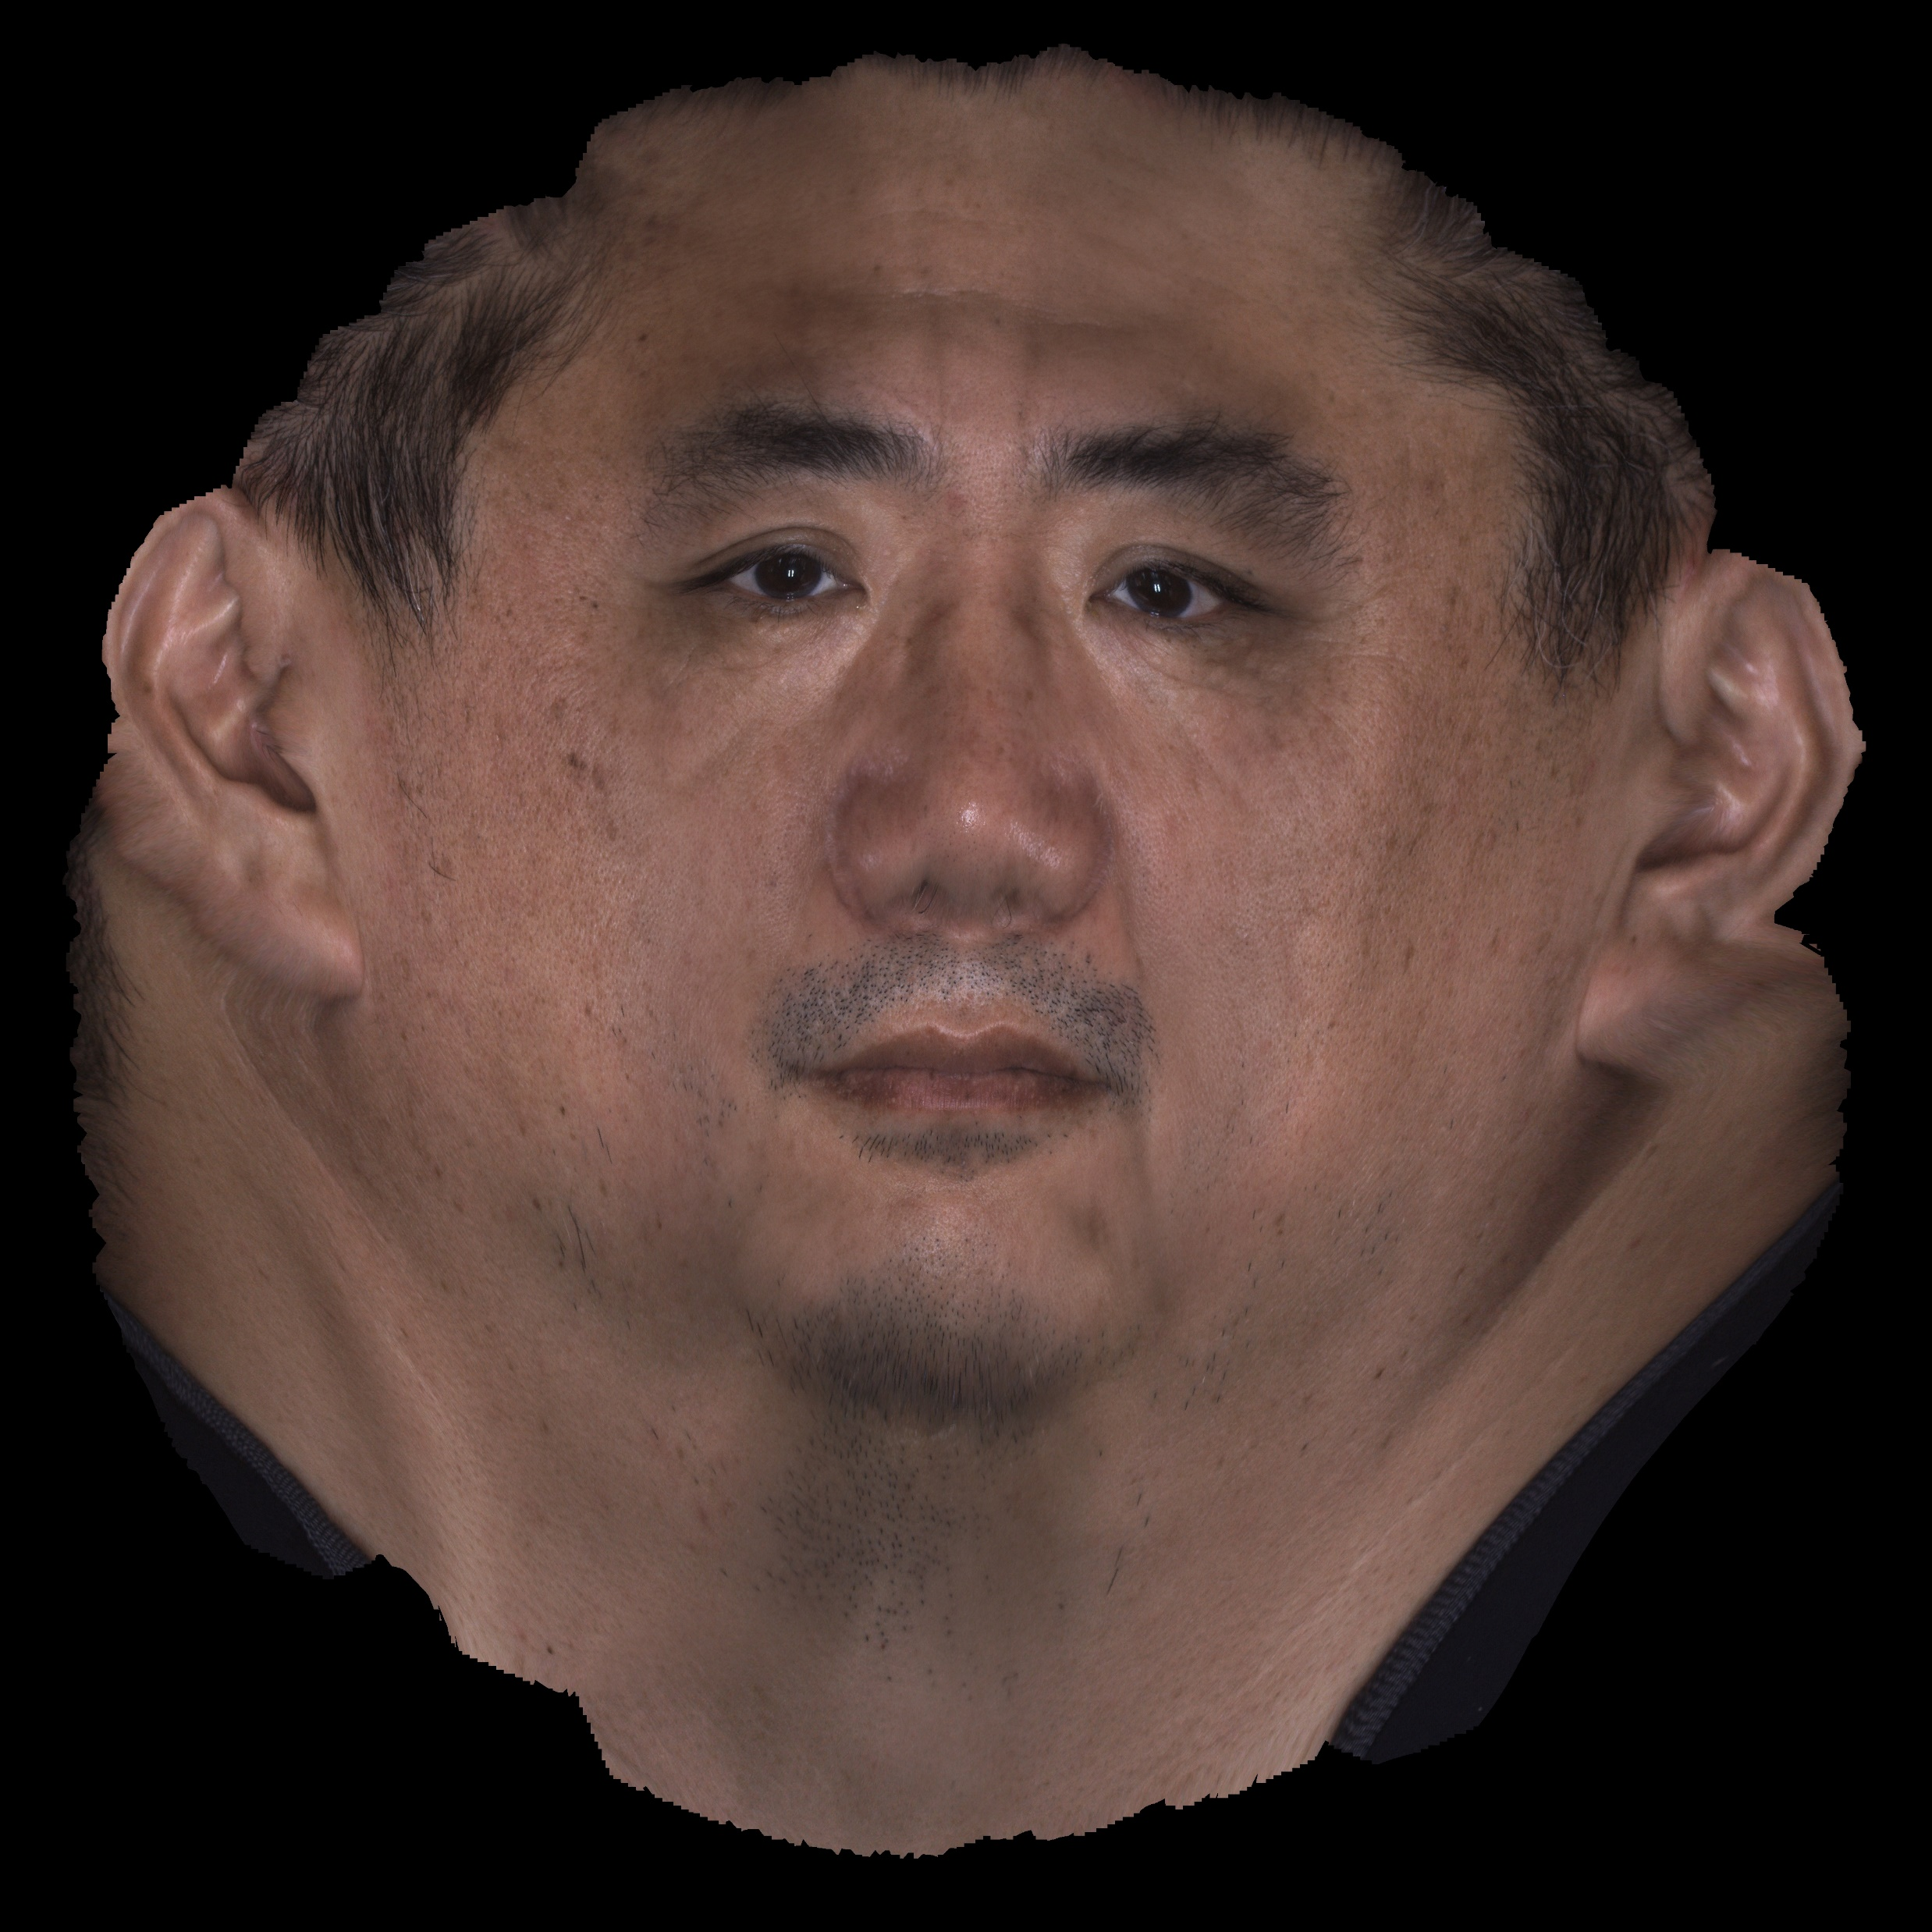
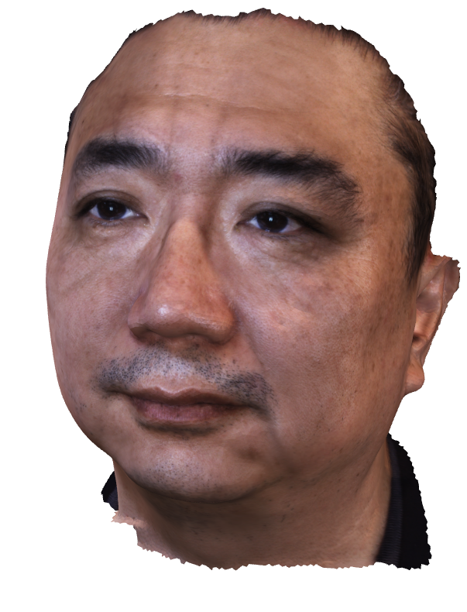
Texture Mapping Example – Wow!

Slide 8
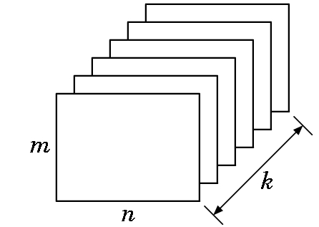
Using Images - framebuffer
a block of memory
n : width , m : height , k : bit-depth
bit plane
any of the k, n x m plane in buffer
Pixel (Picture element)
K values, in position (x , y) in (n , m)
bit plane

Slide 9


Digital Images
image = 2D array of pixel values
monochrome image: GLubyte image[512][512];
color image (R,G,B): GLubyte image[512][512][3];
color image (RGBA): GLubyte image[512][512][4];
color image (RGBX): GLubyte image[512][512][4];

Slide 10
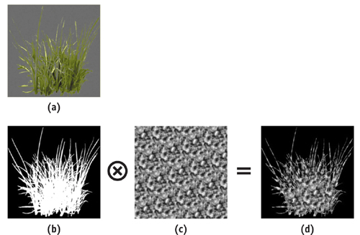
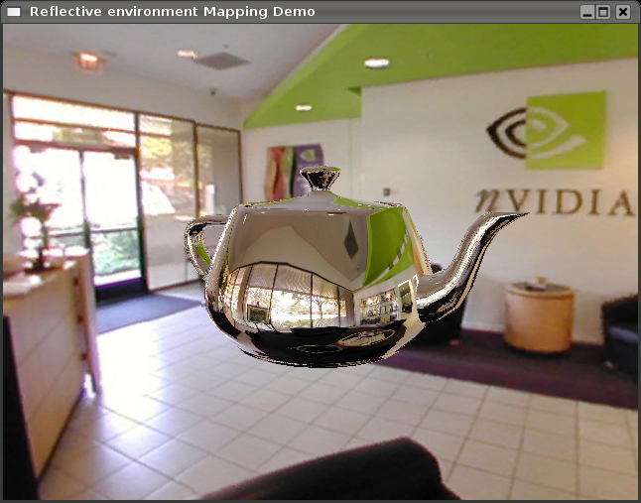
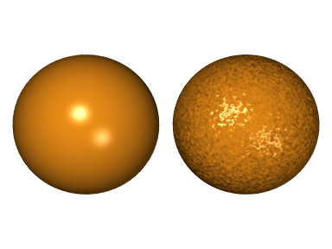
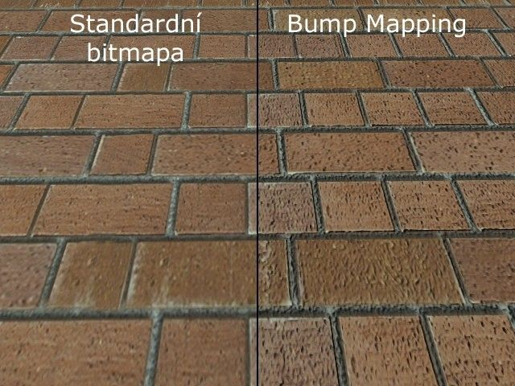
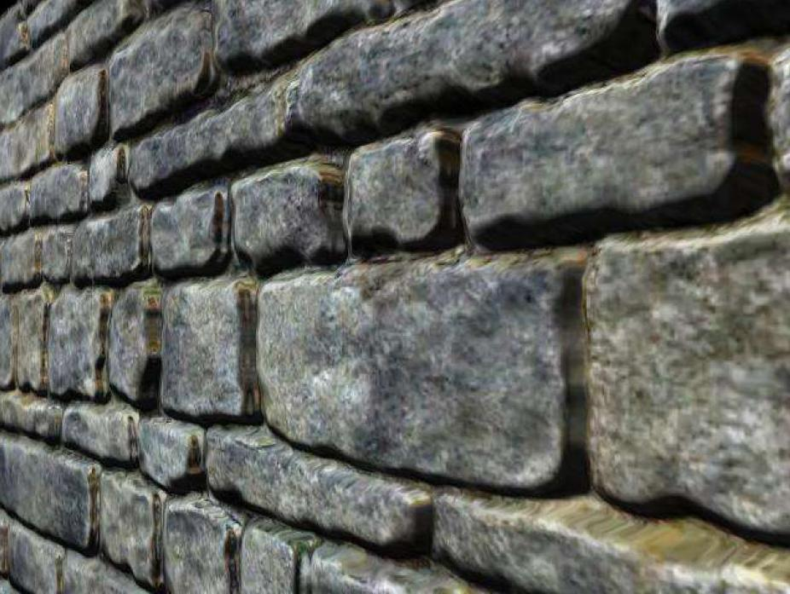
Mapping for what?
Color – Object or Reflection
Depth, Stencil
Displacement, bump (Normal)

Slide 11
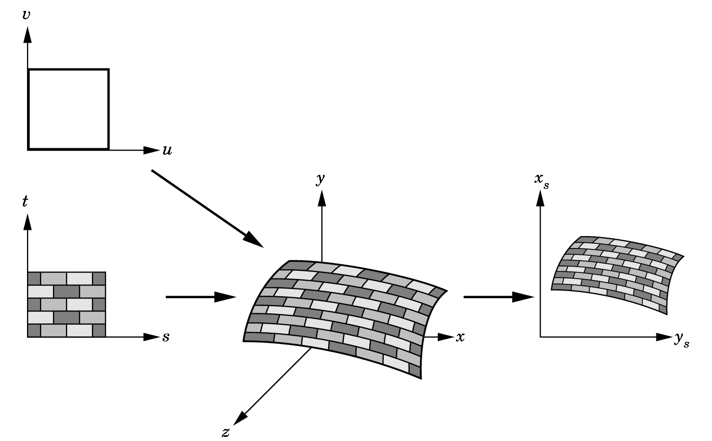
Texture Mapping
texture space (u,v) : 2D image [0,1] × [0,1]
texel : texture element. pixel in the texture
object space (x_{w}, y_{w}, z_{w}) : 3D space
screen space (x_{s}, y_{s}) : 2D screen coordinates

Slide 12
Coordinate Systems
Texture coordinates
Used to identify points in the image to be mapped
Object or World Coordinates
Conceptually, where the mapping takes place
Window Coordinates
Where the final image is really produced

Slide 13
Texture Mapping – Procedures
texture space
(s, t )
object space
(x_{w}, y_{w}, z_{w})
screen space
(x_{s}, y_{s})
forward mapping
backward mapping
pixel : Square
texture space

Slide 14
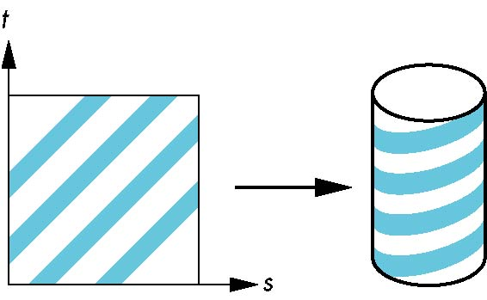
Two-part mapping
One solution to the mapping problem is to first map the texture to a simple intermediate surface
Example: map to cylinder

Slide 15

Cylindrical Mapping
parametric cylinder
x = r cos 2π u
y = r sin 2πu
z = v/h
maps rectangle in u,v space to cylinder
of radius r and height h in world coordinates
s = u
t = v
maps from texture space

Slide 16
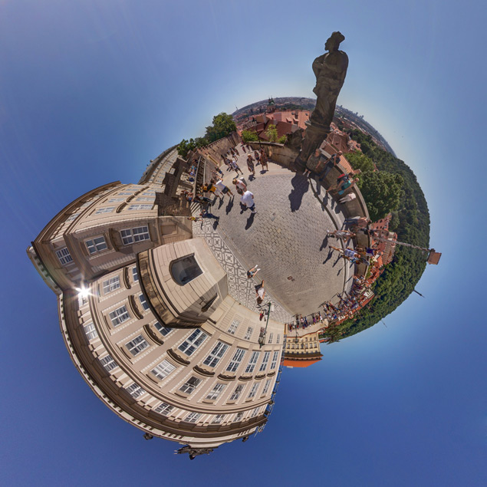
Spherical Map
We can use a parametric sphere
x = r cos 2πu
y = r sin 2πu cos 2πv
z = r sin 2πu sin 2πv

Slide 17
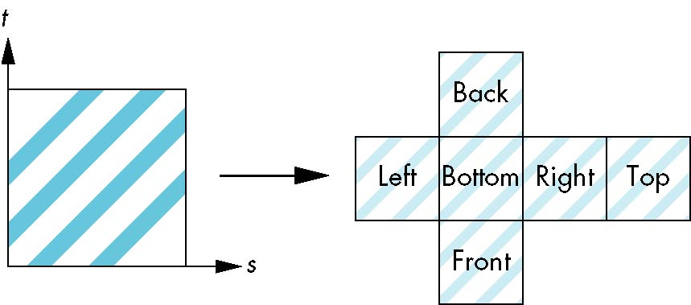
Box Mapping
Easy to use with simple orthographic projection
Also used in environment maps

Slide 18
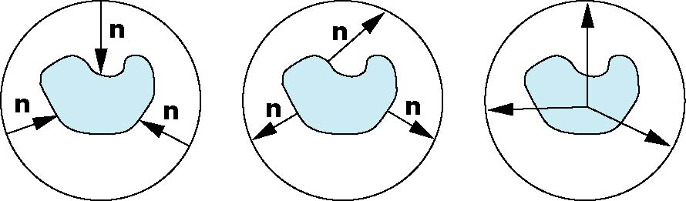
Second Mapping
Map from intermediate object to actual object
Normals from intermediate to actual
Normals from actual to intermediate
Vectors from center of intermediate
actual
intermediate

Slide 19
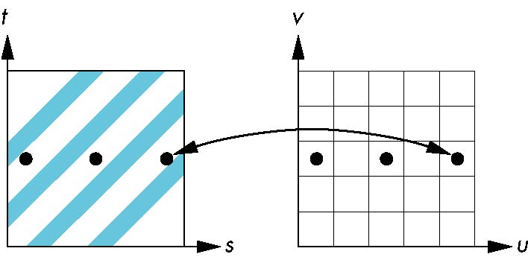
Aliasing
Point sampling of the texture can lead to aliasing errors
miss blue stripes
point samples in u,v
(or x,y,z) space
point samples in texture space

Slide 20
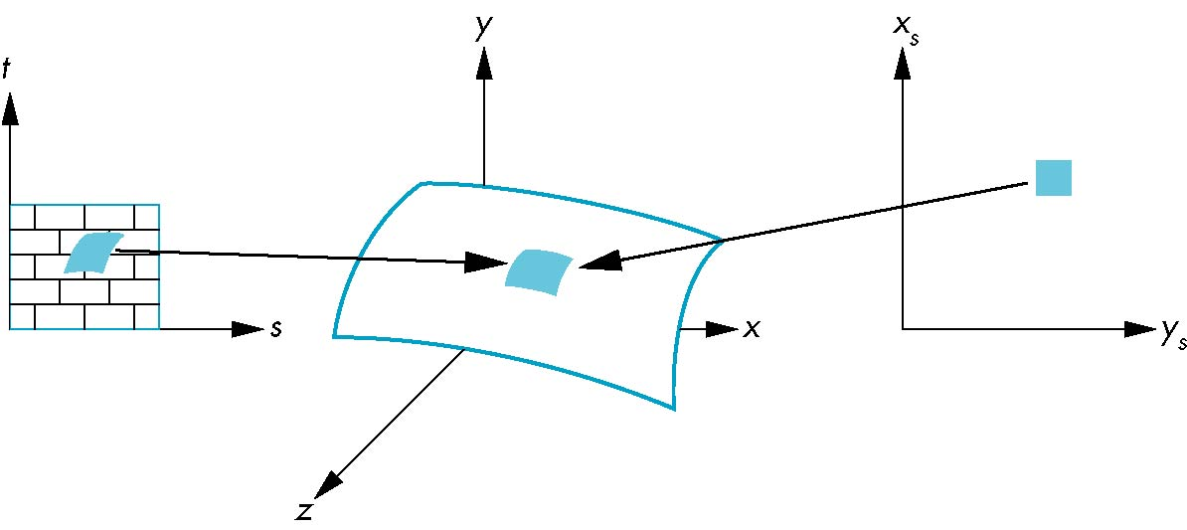
Area Averaging or multi-sampling
pixel
preimage

Slide 21
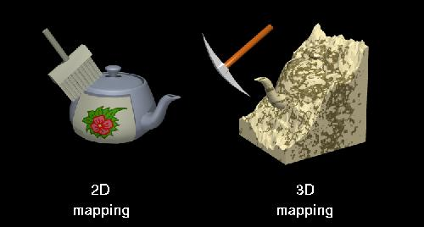
2D and 3D Textures
WebGL 2 supports 3D texture
2D Texture vs. 3D Texture

Slide 22
OpenGL ES 2.0 pipeline diagram
Graphics Context
Buffer (Array, Element)
Vertex Processing
Primitive Processing
Vertex Shader
App
API
Texture
Processing
Rasterization
Texture
Fragment Shader
Fragment Processing
System SW
(Window, Web, HAL)
Framebuffer
(Color, Stencil, Depth)
Pixel
Processing

Slide 23
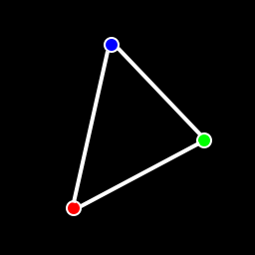
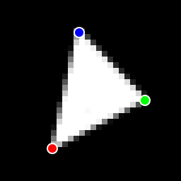
Rasterization Processing
Rasterization
Triangle
Facing Determination
Face Culling
Primitive
Point
Depth offset
Multisampling
Line
Fragment

Slide 24
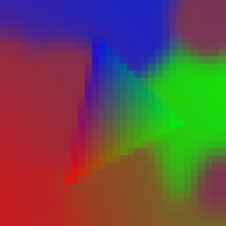
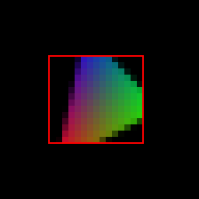
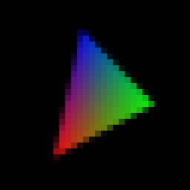
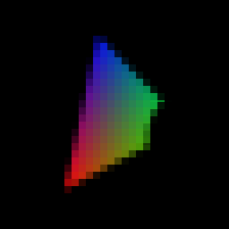
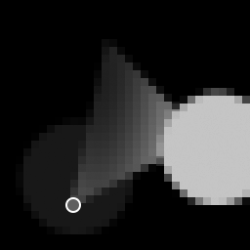
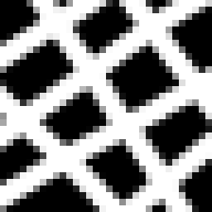
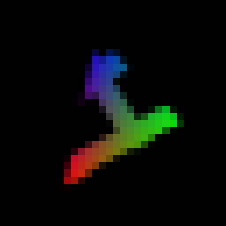
Fragment Processing
Fragment Processing
Fragment (+ varying)
Pixel ownership
Scissor Test
Multi-sample
Frag. Op.
Texture
Fragment shader
Fragment Shading
Pixel
Depth Test
Stencil Test

Slide 25
Overall Texture Pipeline
texture pipeline
texture
unit #0
uniform
texture
object
texture
unit #1
Fragment Shader
texture
image
(in RAM)
sampler2D
Vertex Shader
texture2D(…coord)
vertex attrib
varying uv
vertex attb
(in RAM)
vertex
object

Slide 26
2D Texture
2D array of image data
Texture Base Formats
GL_RGB, GL_RGBA, GL_LUMINANCE, GL_LUMINANCE_ALPHA, GL_ALPHA
Coordinate – (s,t) or (u,v)
Data format
Image – Web Image
Data – Unit8Array, …

Slide 27
Cubemap Texture
Define 6 individual 2D texture faces
Environment mapping
Coordinate (s,t,r)
The texture coordinates for cubemaps are 3D vector directions.
These are conceptually directions from the center of the cube to the texel you want to appear. The vectors do not have to be normalized.

Slide 28
WebGL API for texture
Texture Object and Loading Texture
void gl.genTextures()
n specifies the number of texture objects to generate
textures an array of unsigned integers that will hold n texture object IDs
Object createTexture()
Delete Texture
deleteTexture(Object texture)

Slide 29
WebGL API for texture
Bind Texture
void gl.bindTextures(Glenum target, Gluint texture)
target - bind the texture object to target GL_TEXTURE_2D or GL_TEXTURE_CUBE_MAP
texture - the handle to the texture object to bind
Load Image to Texture (with Data)
void texImage2D(enum target, int level, enum internalformat, long width, long height, int border, enum format, enum type, Object pixels)
target: TEXTURE_2D, TEXTURE_CUBE_MAP_POSITIVE_{X,Y,Z}, TEXTURE_CUBE_MAP_NEGATIVE_{X,Y,Z}
format: ALPHA, RGB, RGBA, LUMINANCE, LUMINANCE_ALPHA
type: UNSIGNED_BYTE, UNSIGNED_SHORT_5_6_5, UNSIGNED_SHORT_4_4_4_4, UNSIGNED_SHORT_5_5_5_1

Slide 30
WebGL API for texture
Load Image to Texture (with Object)
void texImage2D(enum target, int level, enum internalformat, enum format, enum type, Object object)
target: TEXTURE_2D, TEXTURE_CUBE_MAP_POSITIVE_{X,Y,Z}, TEXTURE_CUBE_MAP_NEGATIVE_{X,Y,Z}
format: ALPHA, RGB, RGBA, LUMINANCE, LUMINANCE_ALPHA
type: UNSIGNED_BYTE, UNSIGNED_SHORT_5_6_5, UNSIGNED_SHORT_4_4_4_4, UNSIGNED_SHORT_5_5_5_1
object: pixels of type ImageData, image of type HTMLImageElement, canvas of type HTMLCanvasElement, video of type HTMLVideoElement

Slide 31
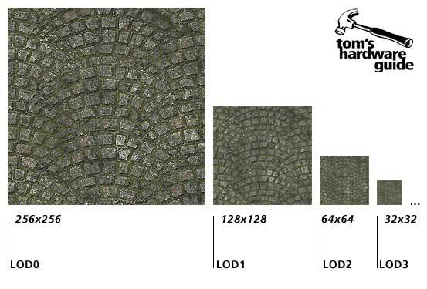
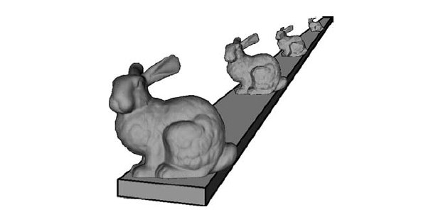
Texture Filtering and Mipmapping
Automatic Mipmap Generation
void generateMipmap(Glenum target) target - GL_TEXTURE_2D or GL_TEXTURE_CUBE_MAP

Slide 32

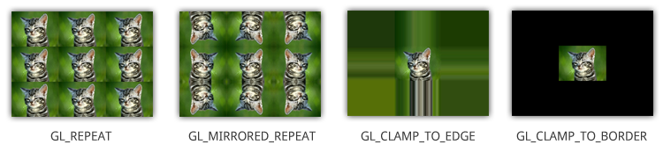
Texture Filtering and Mipmapping
gl.texParameter[fi](target, pname, param) gl.texParameteri[fi]v(target, pname, *params)
target – GL_TEXTURE_2D or GL_TEXTURE_CUBE_MAP
pname & params
GL_TEXTURE_MAG_FILTER - GL_NEAREST or GL_LINEAR
GL_TEXTURE_MIN_FILTER - GL_NEAREST or GL_LINEAR or GL_NEAREST_MIPMAP_NEAREST or GL_NEAREST_MIPMAP_LINEAR or GL_LINEAR_MIPMAP_NEAREST or GL_LINEAR_MIPMAP_LINEAR
GL_TEXTURE_WRAP_S or WRAP_R - GL_REPEAT, GL_CLAMP_TO_EDGE, GL_MIRRORED_REPEAT

Slide 33
Simple Example : Vertex and Fragment Shader for Texture
GLbyte vShaderStr[] =
attribute vec4 a_position;
attribute vec2 a_texCoord;
varying vec2 v_texCoord;
void main()
{
gl_Position = a_position;
v_texCoord = a_texCoord;
} ;
GLbyte fShaderStr[] =
precision mediump float;
varying vec2 v_texCoord;
uniform sampler2D s_texture;
void main()
{
gl_FragColor
= texture2D(s_texture, v_texCoord);
} ;

Slide 34
Texture lookup function in Fragment Shader
Fetch from texture map
vec4 texture2D(sampler2D sampler, vec2 coord[,float bias])
sampler - a sampler bound to a texture unit specifying the texture from which to fetch
coord - a 2D texture coordinate used to fetch from the texture map
bias - an optional parameter that provides a mipmap bias used for the texture fetch. This allows the shader to explicitly bias the computed LOD value used for mipmap selection
vec4 textureCube(sampler2D sampler, vec3 coord[,float bias])
There are more Texture Lookup functions
Check reference card

Slide 35
Cube Texture
Make Separate 6 textures
tex = gl.createTexture();
gl.bindTexture(GL_TEXTURE_CUBE_MAP, tex);
gl.TexImage2D(GL_TEXTURE_CUBE_MAP_POSITIVE_X, 0, GL_RGB, 1, 1, 0, GL_RGB, GL_UNSIGNED_BYTE, &cubePixels[0]);
gl.TexImage2D(GL_TEXTURE_CUBE_MAP_NEGATIVE_X, 0, GL_RGB, 1, 1, 0, GL_RGB, GL_UNSIGNED_BYTE, &cubePixels[1]);
gl.TexImage2D(GL_TEXTURE_CUBE_MAP_POSITIVE_Y, 0, GL_RGB, 1, 1, 0, GL_RGB, GL_UNSIGNED_BYTE, &cubePixels[2]);
gl.TexImage2D(GL_TEXTURE_CUBE_MAP_NEGATIVE_Y, 0, GL_RGB, 1, 1, 0, GL_RGB, GL_UNSIGNED_BYTE, &cubePixels[3]);
gl.TexImage2D(GL_TEXTURE_CUBE_MAP_POSITIVE_Z, 0, GL_RGB, 1, 1, 0, GL_RGB, GL_UNSIGNED_BYTE, &cubePixels[4]);
gl.TexImage2D(GL_TEXTURE_CUBE_MAP_NEGATIVE_Z, 0, GL_RGB, 1, 1, 0, GL_RGB, GL_UNSIGNED_BYTE, &cubePixels[5]);
// Set the filtering mode
gl.texParameteri(GL_TEXTURE_CUBE_MAP, GL_TEXTURE_MIN_FILTER, GL_NEAREST);
gl.texParameteri(GL_TEXTURE_CUBE_MAP, GL_TEXTURE_MAG_FILTER, GL_NEAREST);
return tex;

Slide 36
Compressed Texture
void gl.compressedTexImage2D(GLenum target, GLint level, GLenum internalformat, GLsizei width, GLsizei height, GLint border, GLsizei imageSize, const void *data)
target specifies the texture target, should be GL_TEXTURE_2D or one of the GL_TEXTURE_CUBE_MAP_* face targets
level specifies which mip level to load. The base level is specified by 0 followed by an increasing level for each successive mipmap
internalFormat the internal format for the texture storage. This is the compressed texture format to use. No compressed formats are defined by core OpenGL ES 2.0, so the format used here must come from an extension
width the width of the image in pixels
height the height of the image in pixels
border this parameter is ignored in OpenGL ES, it was kept for compatibility with the desktop OpenGL interface. Should be 0
imageSize the size of the image in bytes
data contains the actual compressed pixel data for the image. These data must hold imageSize number of bytes

Slide 37
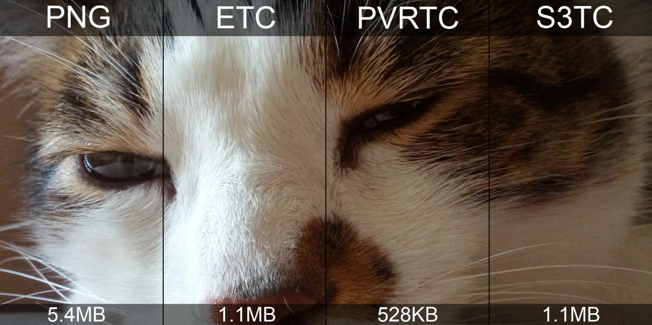
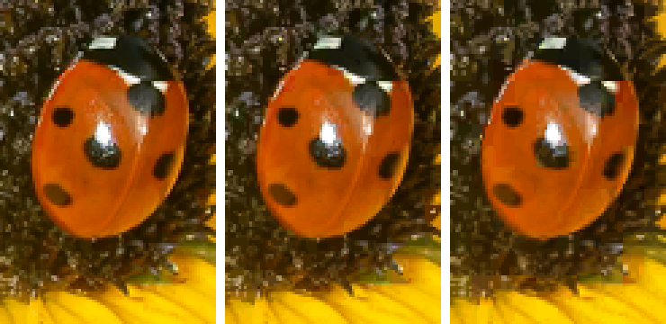
Compressed Texture

Slide 38
Other texture Command (1)
void activeTexture(enum texture)
texture: [TEXTURE0..TEXTUREi] where i = MAX_COMBINED_TEXTURE_IMAGE_UNITS - 1
void copyTexImage2D(enum target, int level, enum internalformat, int x, int y, long width, long height, int border)
target: TEXTURE_2D, TEXTURE_CUBE_MAP_POSITIVE_{X,Y,Z}, TEXTURE_CUBE_MAP_NEGATIVE_{X,Y,Z}
internalformat: ALPHA, LUMINANCE, LUMINANCE_ALPHA, RGB[A]
void copyTexSubImage2D(enum target, int level, int xoffset, int yoffset, int x, int y, long width, long height)
any getTexParameter(enum target, enum pname)
target: TEXTURE_2D, TEXTURE_CUBE_MAP
pname: TEXTURE_WRAP_{S, T}, TEXTURE_{MIN, MAG}_FILTER
bool isTexture(Object texture)

Slide 39
Other texture Command (2)
void texParameterf(enum target, enum pname, float param)
target: TEXTURE_2D, TEXTURE_CUBE_MAP
pname: TEXTURE_WRAP_{S, T}, TEXTURE_{MIN, MAG}_FILTER
void texParameteri(enum target, enum pname, int param)
target: TEXTURE_2D, TEXTURE_CUBE_MAP
pname: TEXTURE_WRAP_{S, T}, TEXTURE_{MIN, MAG}_FILTER
void texSubImage2D(enum target, int level, int xoffset, int yoffset, long width, long height, enum format, enum type, Object pixels)
void texSubImage2D(enum target, int level, int xoffset, int yoffset, enum format, enum type, Object object)
target: TEXTURE_CUBE_MAP_POSITIVE_{X, Y, Z}, TEXTURE_CUBE_MAP_NEGATIVE_{X, Y, Z}

Slide 40
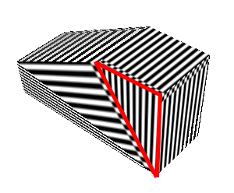
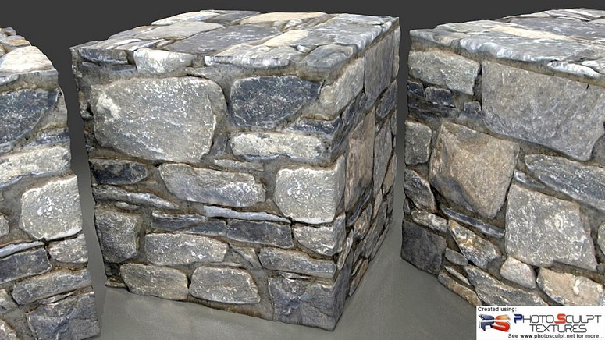
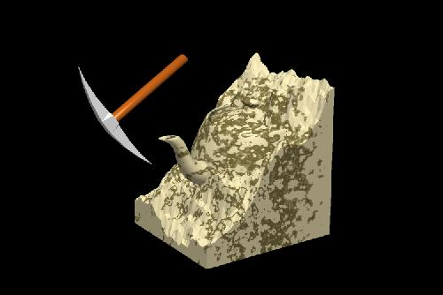
Optional Texture (extension)
3D Texture
void glTexImage3DOES (… void *pixels)
Sh : vec4 texture3D(sampler3D, vec3 coord,…)
void glCompressedTexImage3DOES(… Glsizei depth…)
void glTexImage3DOES(… void *pixels)
void glCompressedTexSubImage3DOES(…)
void glCopyTexSubImage3DOES(…)
Ericsson Texture Compression (ETC)
Floating-Point Texture
Non-Power-of-Two Texture (npot)
Supports but have restriction on the wrap mode
Only CLAMP, filter only GL_NEAREST or GL_LINEAR

Slide 41
Software Tool Time

Slide 43
Lab. 11 Texture Mapping

Slide 45
Software Tool Time (소프트웨어 툴 타임)
(CC-BY-NC 4.0) Hwanyong Lee and Ajou University
Visit “Software Tool Time” channel in YouTube : http://goo.gl/remxrw
This video was supported by the Khronos Group
All product names, trademarks, and/or company names are used solely for identification and belong to their respective owners.
“Software Tool Time” video is licensed to the public under a Creative Commons Attribution 4.0 License (https://creativecommons.org/license/by/4.0/)
Twin Musicom’s African Drums (Sting) is licensed to the to the public under a Creative Commons Attribution 4.0 License (Artist: http://www.twinmusicom.org/)

